Slide 1
Access & Analysis of GLDAS Runoff Over the Sao Francisco Verdadeiro Watershed
17 November, 2022
Notes:
Access and analysis of MODIS NDVI (Normalized Difference Vegetation Index) Over the Sao Francisco Verdadeiro (SFV) Watershed

Slide 2
Objectives
By the end of this exercise, you will be able to download and analyze NDVI (Normalized Difference Vegetation Index) over the SFV watershed and examine inter-annual differences
Requirements
QGIS installed on your computer
https://arset.gsfc.nasa.gov/sites/default/files/water/drought/Introduction%20to%20QGIS.pdf
A shapefile for the Sao Francisco Verdadeiro watershed saved on your computer
http://arset.gsfc.nasa.gov/
NASA Earthdata Account

Slide 3
Outline
Part 1: Subset GLDAS Runoff Data and Make Monthly Time Series
Part 2: Make and Download Monthly Runoff Maps
Part 3: Runoff Analysis in QGIS
Convert NetCDF Runoff data into GeoTIFF
Interpolate and Clip Runoff Data to SFW
Calculate Monthly Accumulated Runoff over the SFV Watershed

Slide 4
Subset GLDAS Runoff Data and Make Monthly Time Series

Slide 5
Subset Data and Make Monthly Runoff Time Series
Go to Giovanni: http://giovanni.gsfc.nasa.gov/giovanni
On the Giovanni page you will see the following options:
Select Plot: allows selection of analysis options
Select Data Range: allows selection of a time period
Select Region (Bounding Box or Shapefile): allows selection of a geographic region by latitude-longitude, map, or shapefile
Keyword: allows search of data parameters by keyword
Plot Data: (located on the bottom right of the page) begins the action to make a desired plot

Slide 6
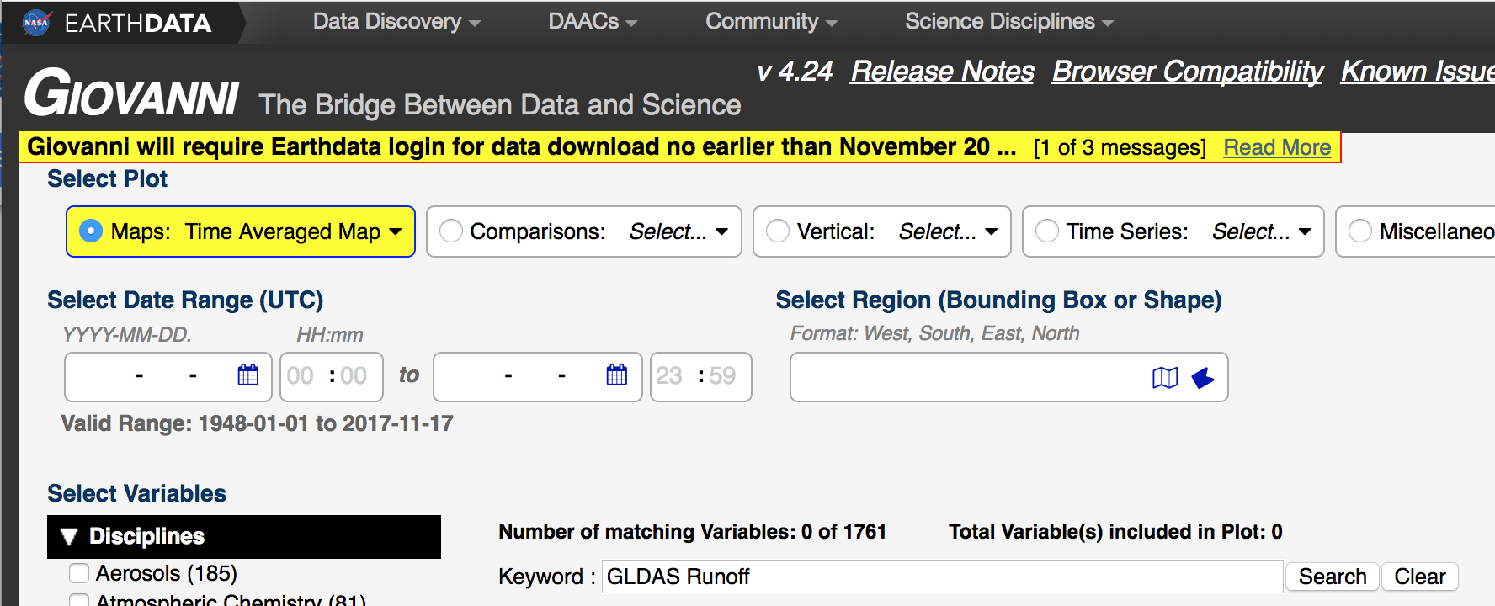
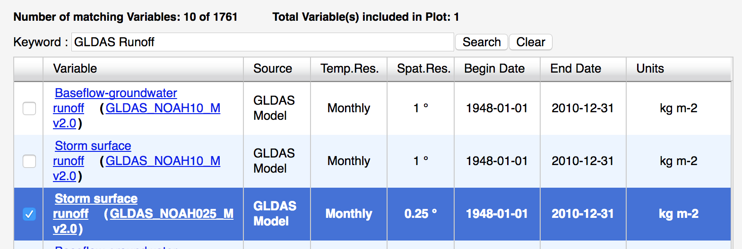
Subset Data and Make Monthly Runoff Time Series
Enter the following options:
For Keyword, enter GLDAS Runoff. Click Search
Select Storm surface runoff (GLDAS_NOAH025_Mv2.1) Monthly data

Slide 7
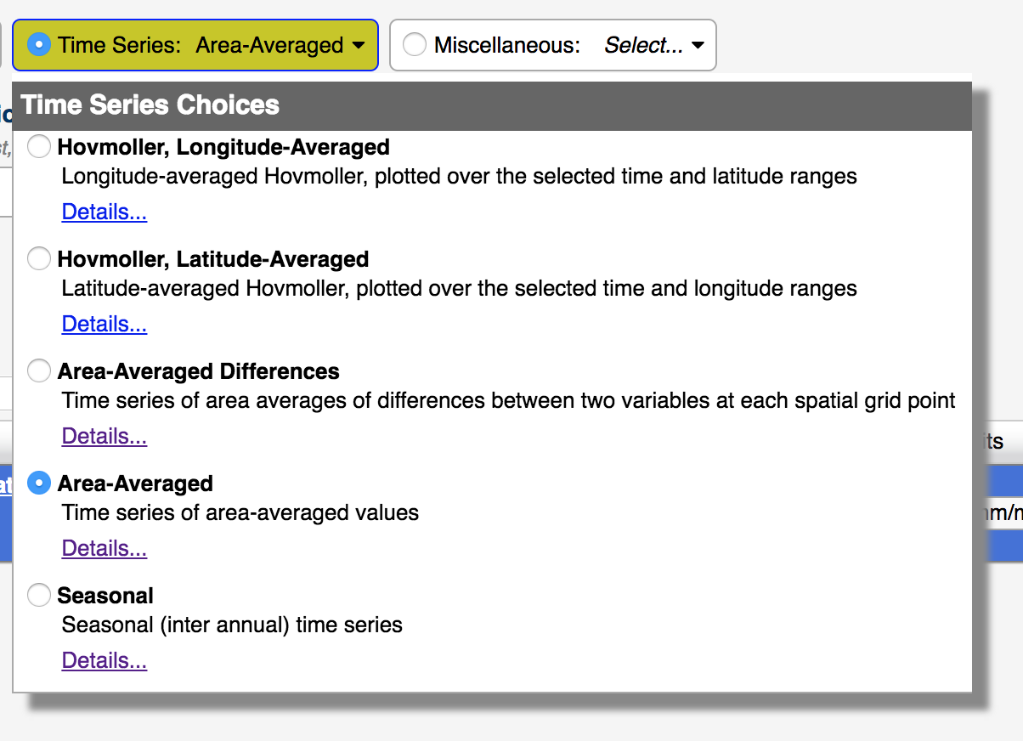
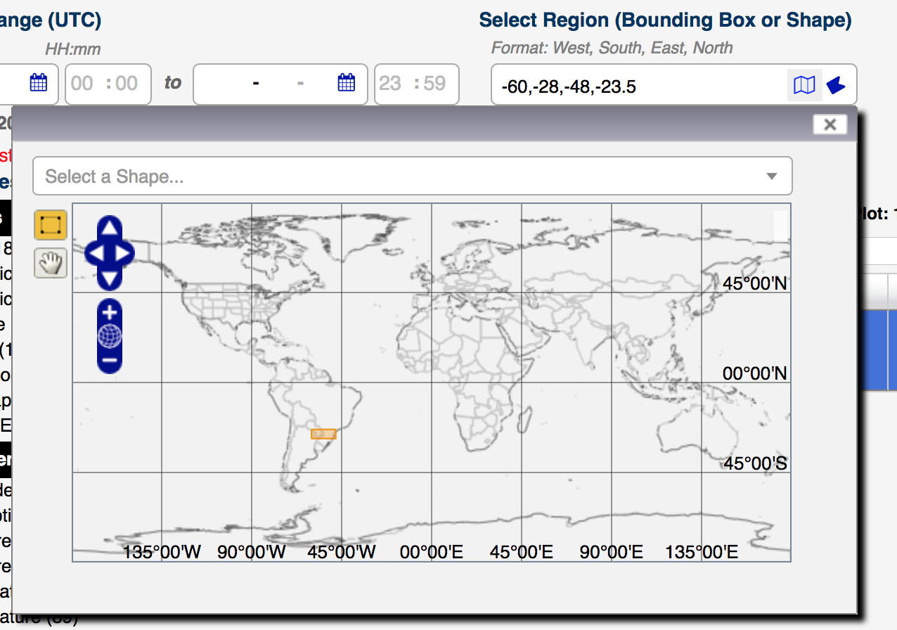

Subset Data and Make Monthly Runoff Time Series
Under Select Plot, the default selection is Maps: Time Averaged Map. Select Time Series, and then select Area Averaged from the drop-down menu
Under Select Region (Bounding Box or Shape), enter the longitude-latitude around Parana: -60.0, -28.0, -48.0, -23.5
Note: west longitudes and south latitudes are negative, whereas east longitudes and north latitudes are positive
Click on the map icon to see the region

Slide 8
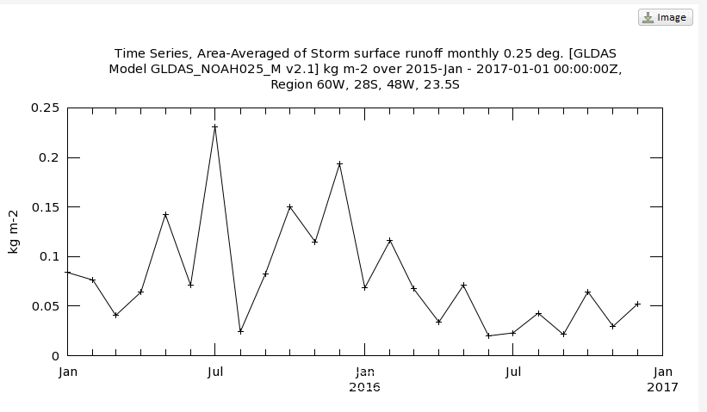
Subset Data and Make Monthly Runoff Time Series
Under Select Date Range (UTC), in the YY-MM windows, enter 2015-01 for start date and 2016-12 for the end date
Click on Plot Data (on the bottom right-hand of the screen) to get the time series plot on the right

Slide 9
Make and Download Monthly Runoff Maps

Slide 10

Make and Download Monthly Runoff Maps
Click on Back to Data Selection on the lower, right-hand side of the page
Enter the following options:
Under Select Plot, change to Maps: Monthly and Seasonal
Under Select Seasonal Dates, enter December and 2015 to 2015 (just the one month)
Click on Plot Data (on the bottom right) to get a map of monthly Runoff
Click on the Downloads link on the left to see multiple file options. Choose the NetCDF file by clicking on the link to save the file to your computer
Suggestion: Save the December 2015 monthly files in the folder Panara-Data you created for the GPM IMERG data

Slide 11

Make and Download Monthly Runoff Maps
Click Back to Data Selection on the bottom right part of the screen
Repeat Select Date Range for December 2016
Click on the Downloads link on the left and save the NetCDF file on your computer in the same folder as December 2015
Suggestion: Rename the NetCDF files to avoid long, Giovanni-generated file names. For example: Runoff-Dec2015.nc and Runoff-Dec2016.nc

Slide 12
Runoff Analysis in QGIS

Slide 13

Runoff Analysis in QGIS
Note: You will need the latest version of QGIS (Preferably 2.18.9 or higher) to work with the NetCDF files. It is always a good idea to save your QGIS project often so that your work is not lost.
Open QGIS and start a new project
On the top menu bar, click on Web to check if you have OpenLayers Plugin
If you do not have the OpenLayers Plugin
Select Plugins from the top menu, and choose Manage and Install Plugins
You will get a window with options for Plugins
Enter OpenLayers in the search window
Clicking on the OpenLayers Plugin and press Install in the bottom right

Slide 14
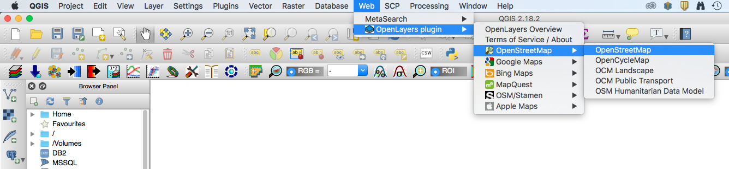
Runoff Analysis in QGIS
From the top menu bar, click on Web, select Open Layer Plugin and select a background map
This exercise uses the plugin OpenStreetMap

Slide 15
Add the SFV Shapefile
Click on the menu on the left bar and click Add Vector to add the SFV shapefile: sfv_4326.shp
To make the shapefile transparent with only the border left, right click on the layer file and go to Properties > Style
Click on the down arrow in the Fill window and select Transparent fill
Click on the down arrow in the Outline window and choose a color of the shapefile boundary (This example uses black)
Set the outline width to be 2.0
Click OK to get the following result in the QGIS window

Slide 16

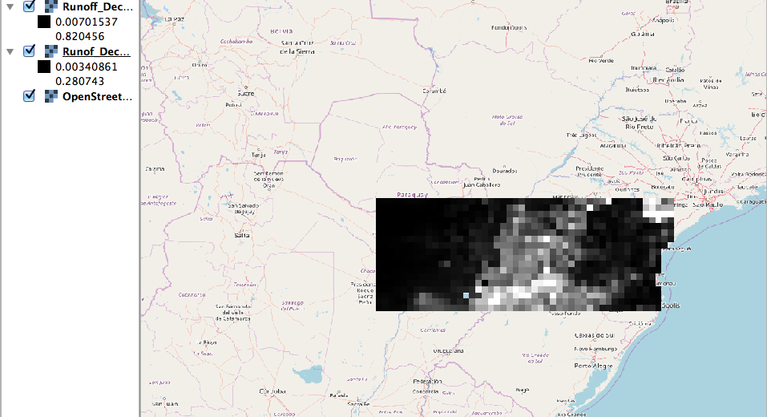

Convert NetCDF Runoff Data to GeoTiff
11. In your QGIS map, click on the Add Raster function on the left
12. Navigate to your saved Monthly Runoff Files and click on Open to add the monthly data files for December 2015 and December 2016. You can do this all at once by highlighting both files.
A Coordinate Reference System Selector box may pop up. Select WGS84, EPSG 4326
From the top Menu Bar, you can zoom in and out on the layer
These NetCDF images have to be converted to GeoTIFF images for you to perform raster calculations on the data.

Slide 17
Convert NetCDF Runoff Data to GeoTiff
13. Right-Click (or Control-Click on Mac) on the raster layer Runoff-Dec2015
14. From the drop-down menu select Save As – this will open a window
Note that Format in the window is Gtiff
Make sure the Add save file to map option is checked.
Click on Browse and enter the folder name where all the data are and enter a file name (Suggestion: Runoff-Dec2015) and click on Save
You will see the GeoTiff layer displayed on the map and the file will be saved to the data folder
15. Repeat steps 13-14 to save the 2016 Runoff layer as a GeoTIFF
16. Now you can remove the NetCDF raster layers by right-clicking on each layer and choosing Remove

Slide 18
Resample the Runoff Data
In the top menu, select Processing > Toolbox. A search window will appear to the right of the map. Enter interp.
You should see r.resamp.interp from the list
Double click on r.resamp.interp – this will open a window
In the Input Raster Layer window use the dropdown menu arrow to select Runoff_Dec2015 raster
In the Sampling interpolation method window, chose nearest
In the GRASS GIS 7 region extern (xmin,xmax,ymin,ymax) window choose Layer/canvas extent from the dropdown menu
In the GRASS GIS 7 region cellsize (leave 0 for default) window enter the factor 0.01 [Note: the resolution of the Runoff data is 0.25 degree, we are resampling the data to1 km by specifying 0.01 cell size) without changing values

Slide 19
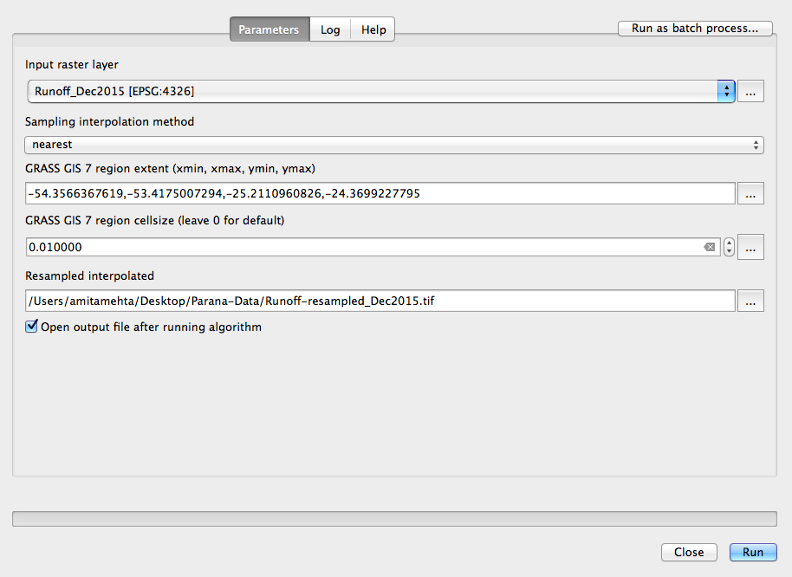
Resample the Runoff Data
In the Resampled Interpolated window specify the folder and filename where the interpolated data will be saved.
Make sure that Open output file after running algorithm is selected
Click on Run at the bottom right
You will get a resampled interpolated data layer on the map (in grey colors)
By right clicking on the resampled layer > Rename layer:
(suggest Runoff_resampled_Dec2015)
Repeat the above steps and resample the 2016 Runoff data
You may uncheck or remove Runoff layers which are not resampled

Slide 20
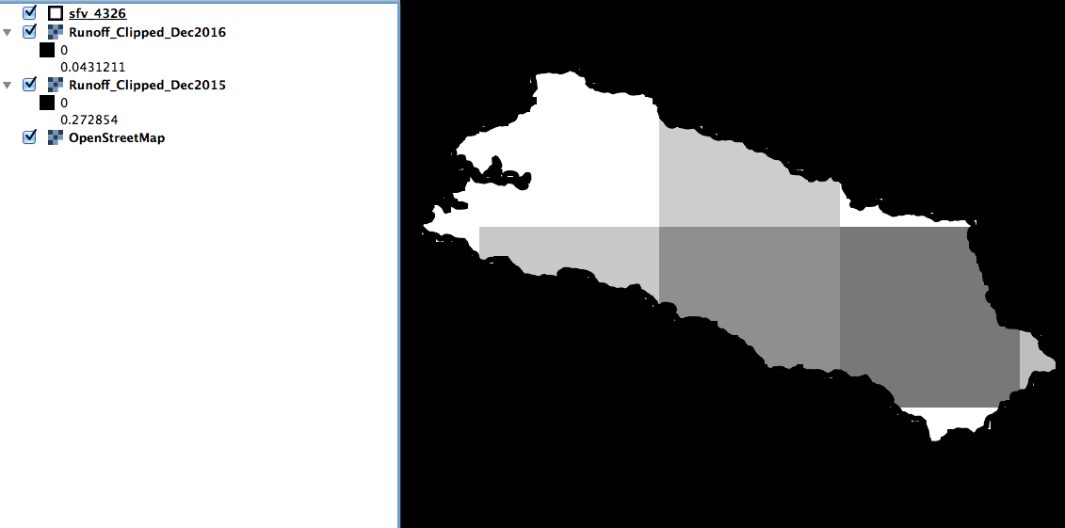
Clip the Runoff Data to the SFV Watershed
Now Clip the interpolated Runoff layers to the SFV shapefile. On the top bar go to Raster > Extraction > Clipper to open the Clipper options window
In the Input File (raster) window select layer Runoff_resampled_Dec2015
In the Output file window select output folder and enter file name (suggest Runoff_Clipped-Dec2015).
Check the Mask Layer and in the Mask Layer window select the shapefile name sfv_4326.
Click OK on at the bottom right. You will see the data clipped by the shapefile boundary

Slide 21
Note
The original Runoff data from GLDAS is at 0.25° resolution
We resampled the data because spatial interpolation of Runoff will result in unrealistic distribution of Runoff (Runoff depends on factors such as slope, land cover type, soil moisture, and soil type)
The GLDAS Runoff only provides large-scale Runoff pattern (~ 25 km x25 km)
The monthly Runoff value in GLDAS is given as an average of 3-hourly data over the month
Therefore, in order to estimate total monthly runoff we have to multiple the monthly average value as:
(Runoff (Kg/m²)/3 hr) * (8 (3-hr times) /day)*(31 day/month)
In the next exercise we will use the Raster Calculator to get total monthly Runoff

Slide 22
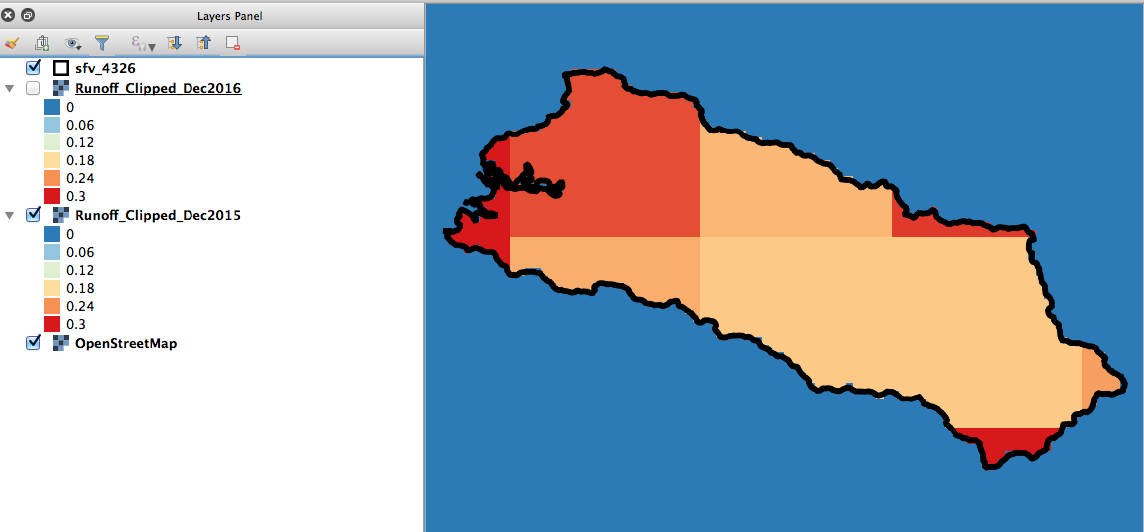
Add Color to GeoTIFF Runoff Data
Right click on the layer file for December 2015 and go to Properties > Style
Select the Render Type as Singleband Pseudocolor
Next to Color, make sure the Red-Yellow-Blue (RdYlBu) color palette is selected
Select Invert so that low Runoff values are shown in blue and high in red
Set Min value to 0 Kg/m² and Max value to 0.3 Kg/m²
Below the color display, change the Mode to Equal Interval and Classes to 6
Click Classify, then click Apply
Repeat the above steps for December 2016 layer

Slide 23
Discussion
Over the SFV watershed, which year had more runoff in December?
Recall the GPM precipitation analysis conducted on Day-4. Explain the inter-annual differences in runoff with respect to the precipitation differences.
How can you get high resolution runoff data?

